Slide 1
Does Your Face Have a Mask On It?
By Brian Tonnies, Michael McGaw

Slide 2
Purpose:
Masked = *on* if hasmask else *off*

Slide 3
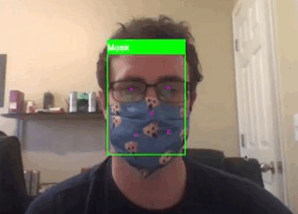
Resources Utilized
Tensorflow: Keras
OpenCV
Google Search
Brian Tonnies
Jupyter Notebook
So you can try this too!

Slide 4
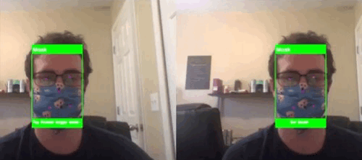
Top-ranked Kaggle Face Mask Detection Contest Model
Our Model
Best Run

Slide 5
Discussion:
We regret not changing the layout of the models beforehand; of the 34 models trained, the model that performed the best is the model that had a different pattern of layers than the rest.
Changes that could be made:
Different Optimizer
More changes to the pattern of the layout -> mas models

Slide 6
Questions?

